Slide 1

Git Good: Introduction to GitHub for Collaboration
Sophia Batchelor, and Esther Plomp
https://github.com/alan-turing-institute/the-turing-way, @turingway, CC-BY 4.0. DOI 10.5281/zenodo.7788718

Slide 2
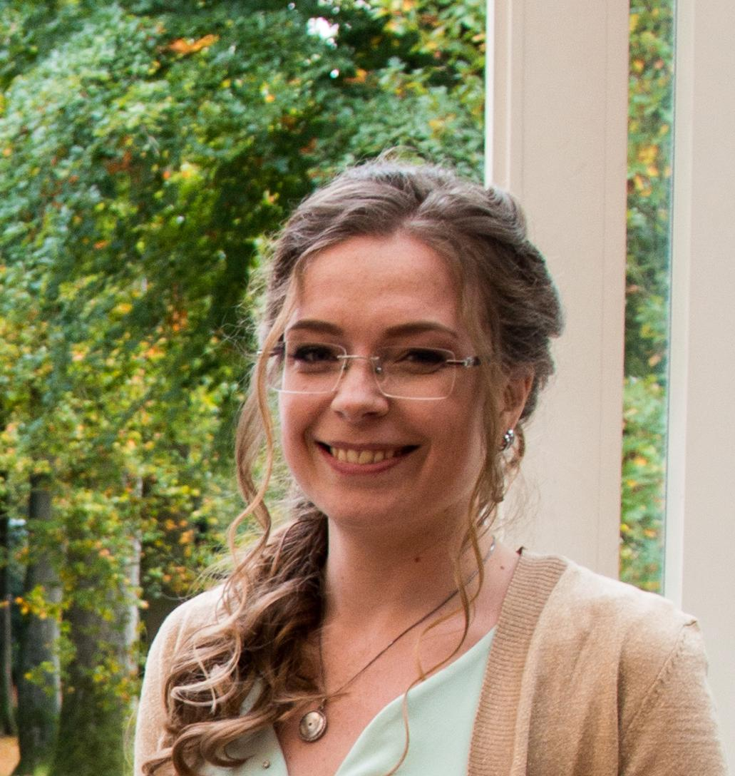

Introductions
Esther Plomp Data Steward, Delft University of Technology.
Core Contributor
The Turing Way
Sophia Batchelor
Research Community Manager
Alan Turing Institute
Core Contributor, The Turing Way
https://github.com/alan-turing-institute/the-turing-way, @turingway, CC-BY 4.0. DOI 10.5281/zenodo.7788718
https://github.com/alan-turing-institute/the-turing-way, <personal twitter>, @turingway, CC-BY 4.0, DOI: 10.5281/zenodo.<update>

Slide 3

Icebreaker
The Alan Turing Institute
To get us started…
We’ll be diving straight into the deep end!
github.com/alan-turing-institute/the-turing-way/issues/3006
SHORTENED URL: tinyurl.com/mrxvd496
https://github.com/alan-turing-institute/the-turing-way, @turingway, CC-BY 4.0. DOI 10.5281/zenodo.7788718

Slide 4
Overview
What is The Turing Way?
Github Introduction
How to use GitHub for Collaboration
Next Steps
https://github.com/alan-turing-institute/the-turing-way, @turingway, CC-BY 4.0. DOI 10.5281/zenodo.7788718

Slide 5
Overview
What is The Turing Way?
Github Introduction
How to use GitHub for Collaboration
Next Steps
https://github.com/alan-turing-institute/the-turing-way, @turingway, CC-BY 4.0. DOI 10.5281/zenodo.7788718

Slide 6
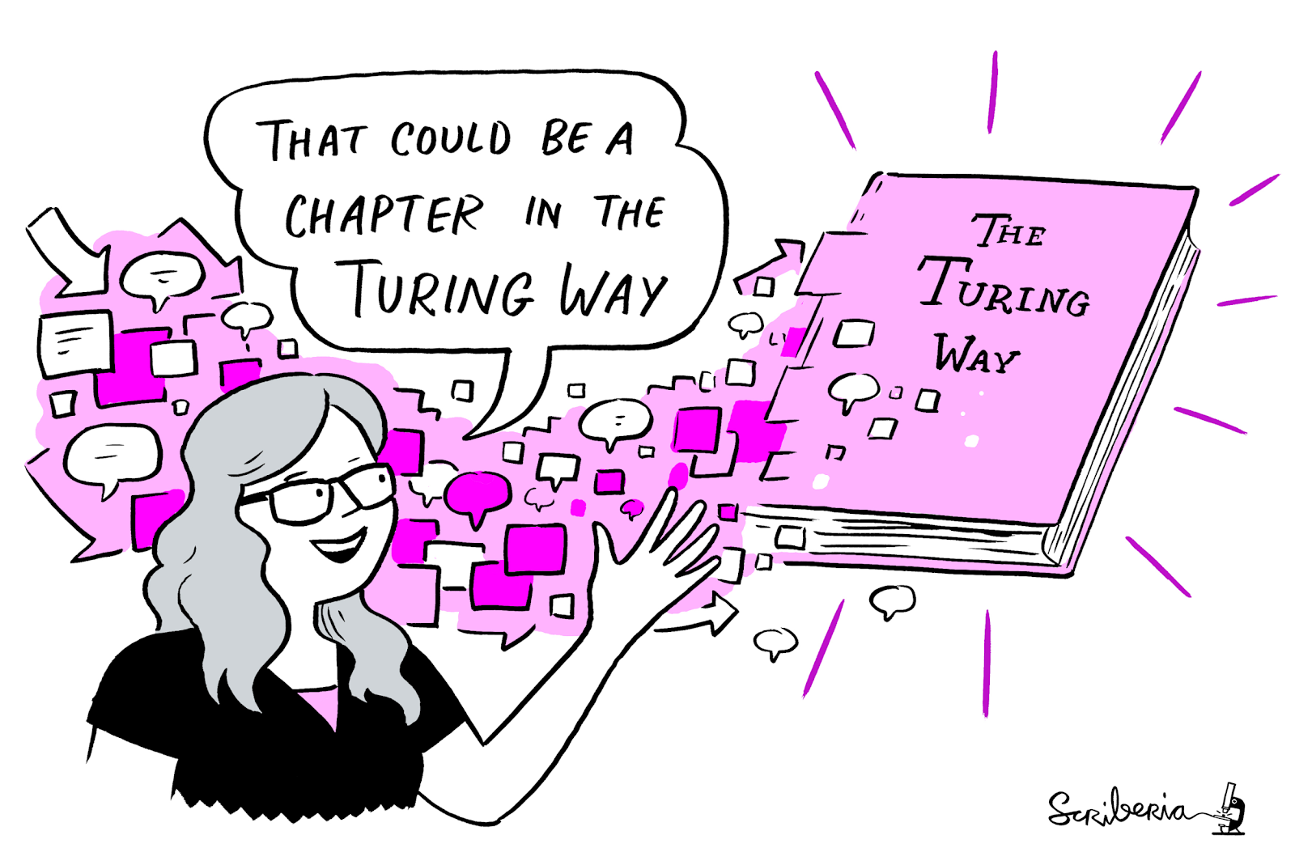
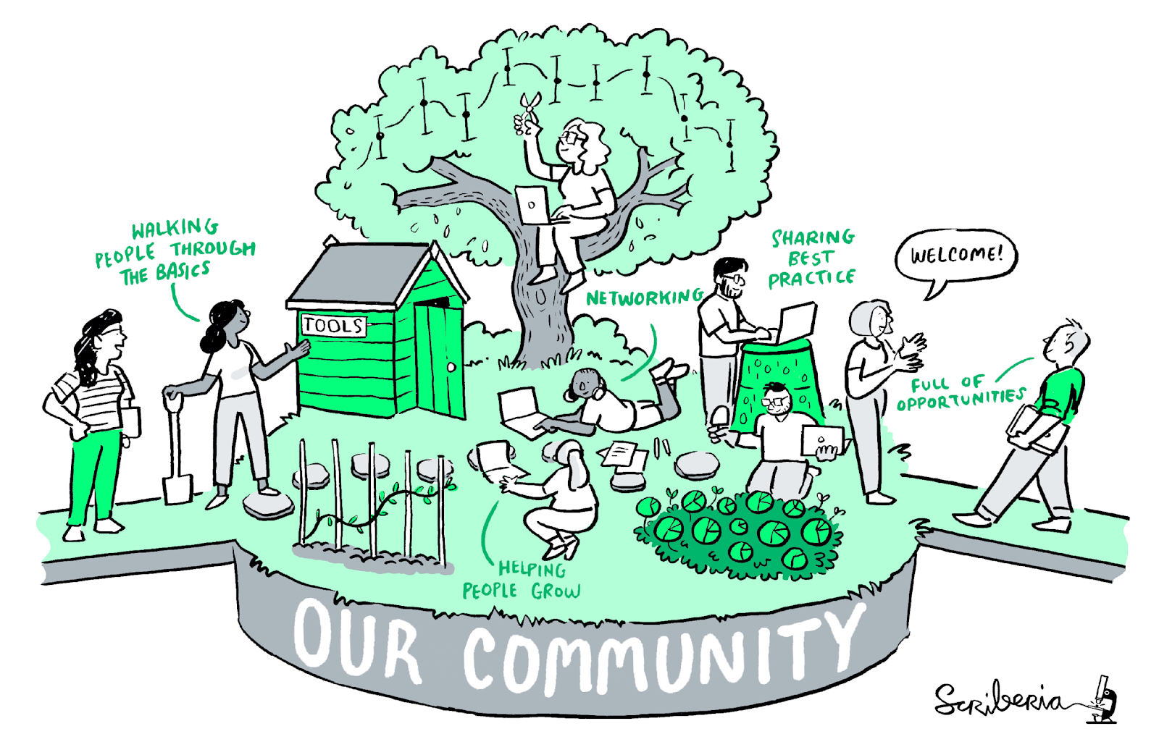
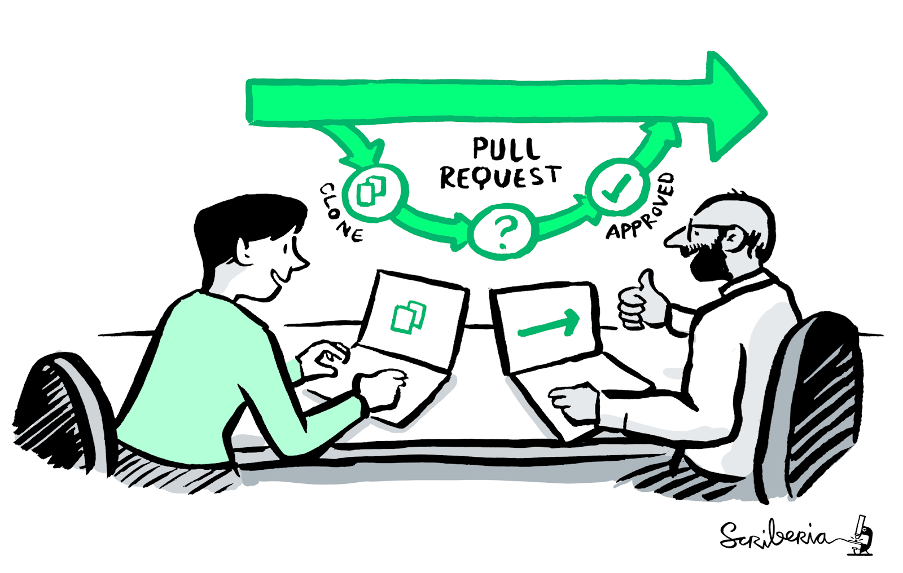
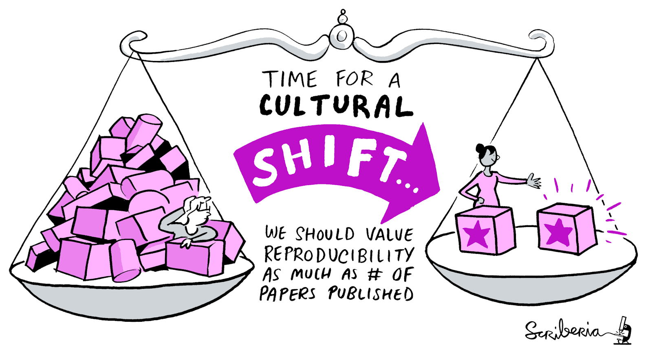
The Turing Way
An Open Source guide on Data Science
We involve and support a diverse community to make data science reproducible, ethical, collaborative and inclusive for everyone
A Book
A Global Community
An Open Source Project
A Culture of Collaboration
https://github.com/alan-turing-institute/the-turing-way, @turingway, CC-BY 4.0. DOI 10.5281/zenodo.7788718. Image credit Scriberia.
Notes:
So what is the Turing Way. Its a wikipedia put together by researchers and expert. For us- its 4 things at once- its a book, a community where people come together to collaboratively write chapters, build and maintain resources, share their skills and ideas around best practices in data science and research. Somewhere where open source principles are applied in the development and maintenance of this project and a collaboration- the process of this is the backbone of our project
The aim is to make collaborative, reusable and transparent research too easy not to do.

Slide 7




What is open source?
Roots in free software movement
Licensing allowed for modifications and derived works
Developed into free and open source software (F/OSS) movement
Influenced ‘open’ movements: open knowledge, open data, open access, open science
https://github.com/alan-turing-institute/the-turing-way, @turingway, CC-BY 4.0. DOI 10.5281/zenodo.7788718
Notes:
The Turing Way is a product of – and belongs to – our community of contributors. This means that it’s open by design, and collaborative in practice. In real time, this means that we use open source tools & methods to collaborate, and open framework for collaboration, peer production and project sustainability – so that users collaborate to build resources that are beneficial for them.
Ultimately, this means that we aim to be open all the way down. In fact, we would argue that The Turing Way has grown within a short amount of time because it has been designed to be open.

Slide 8
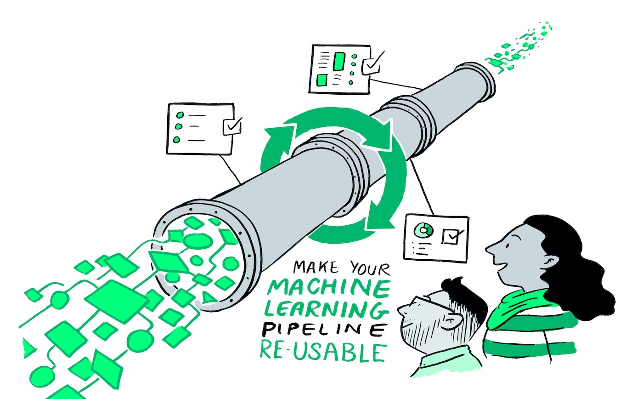
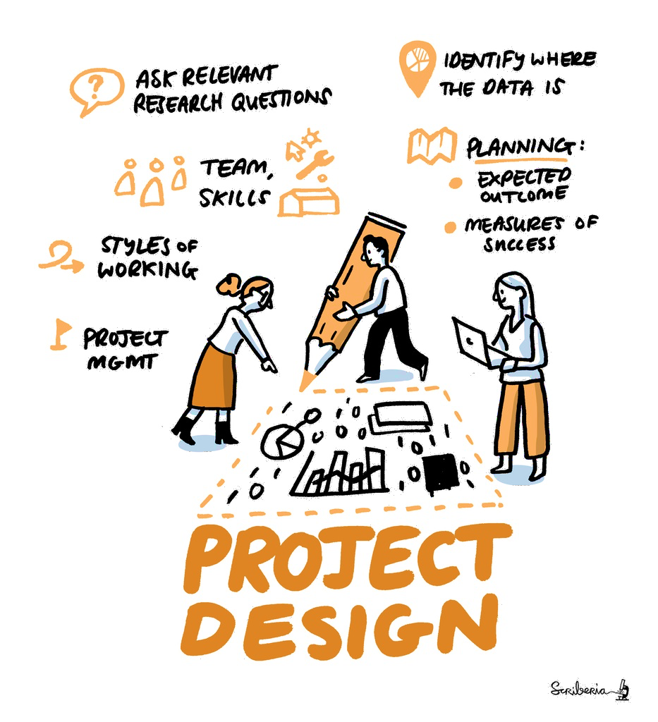
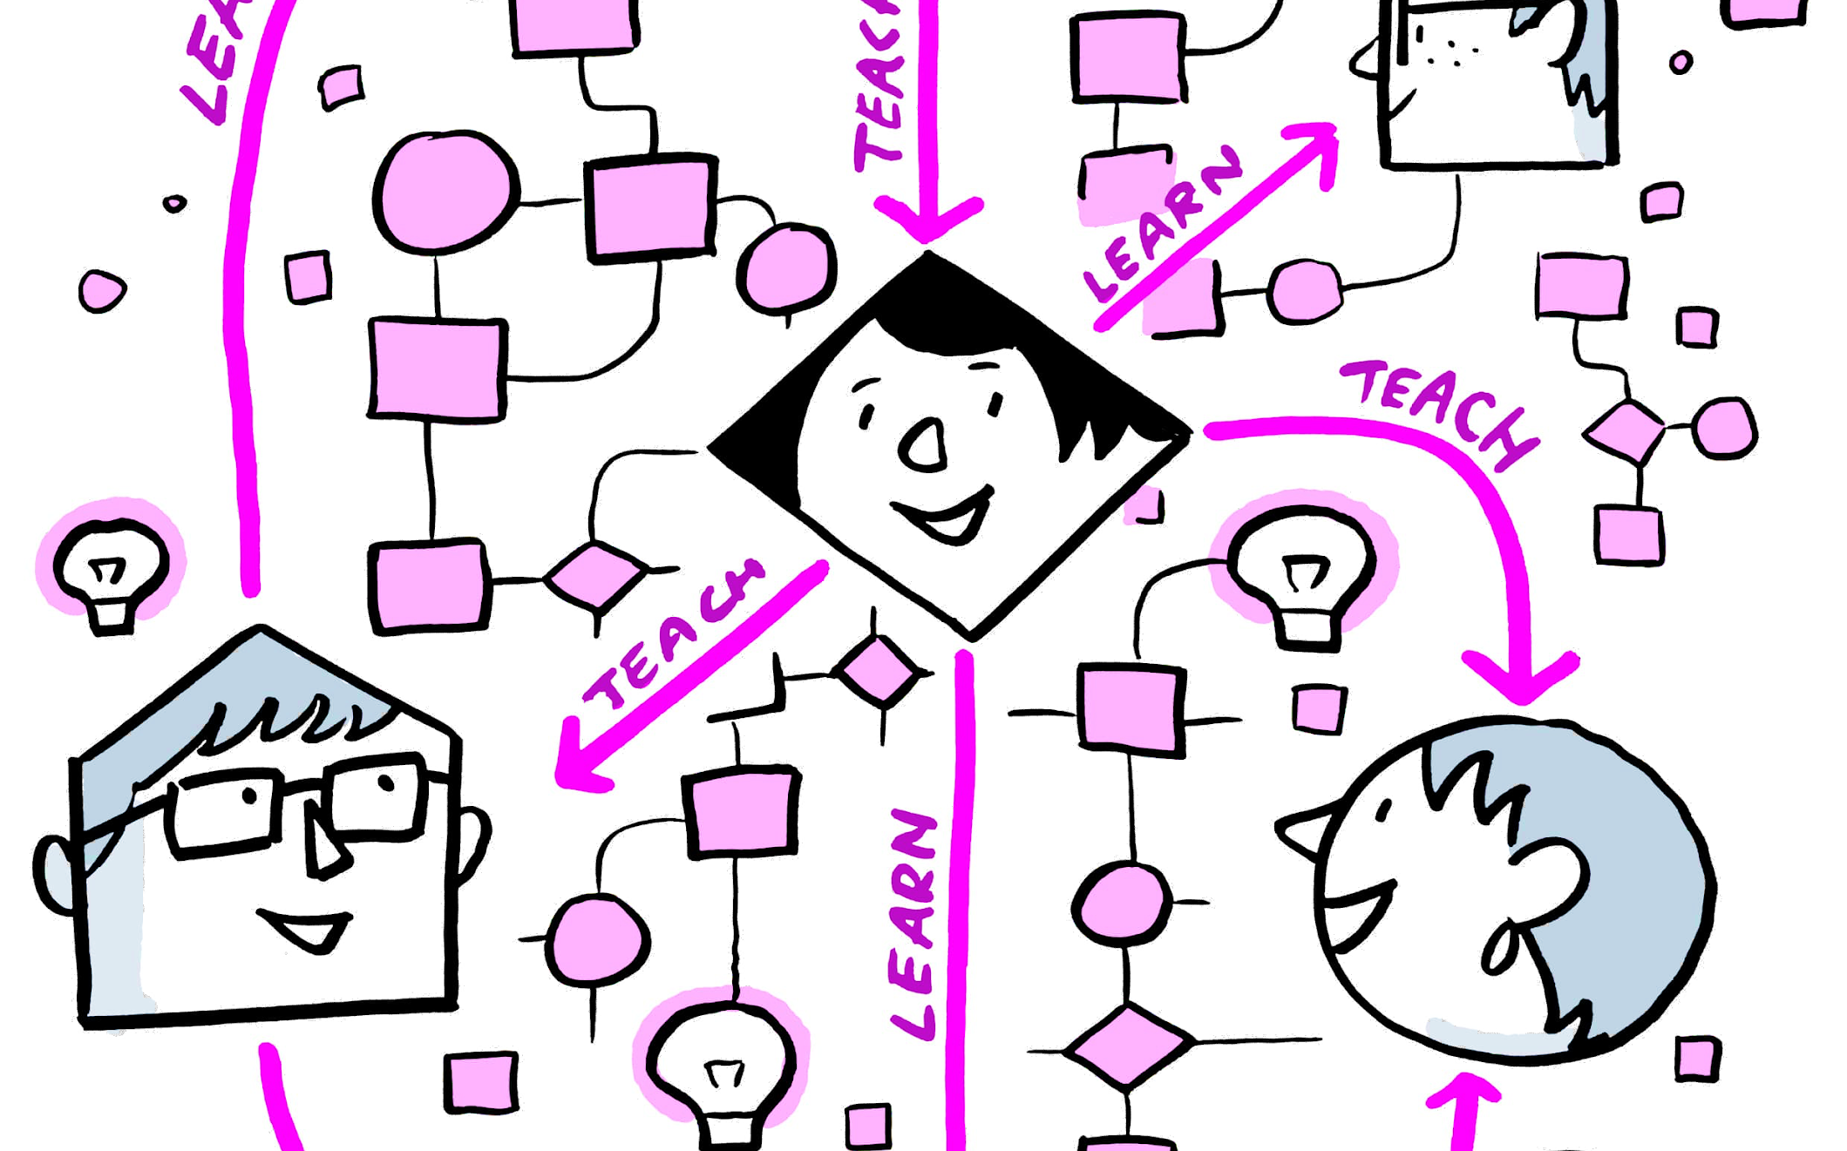
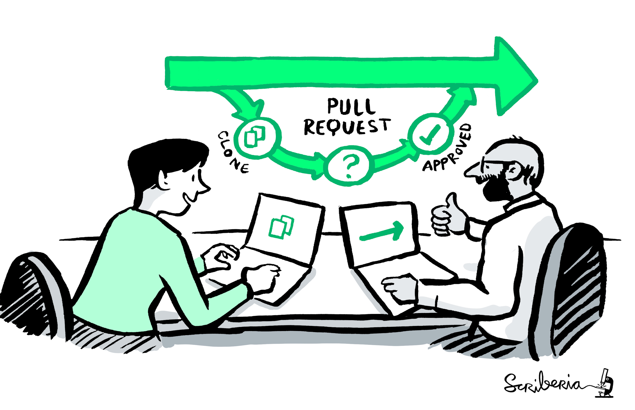
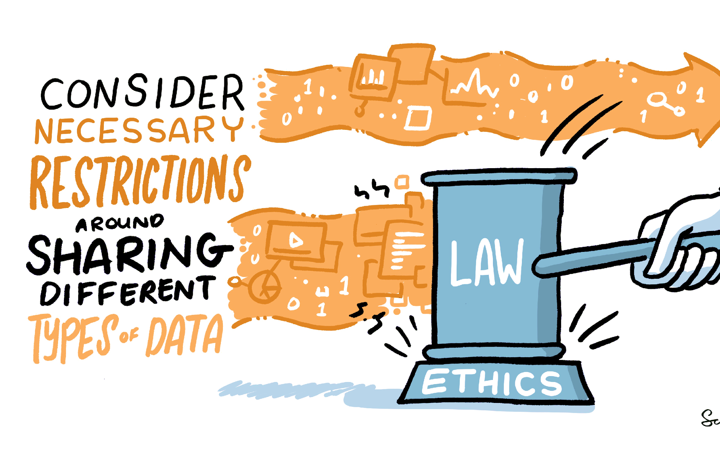
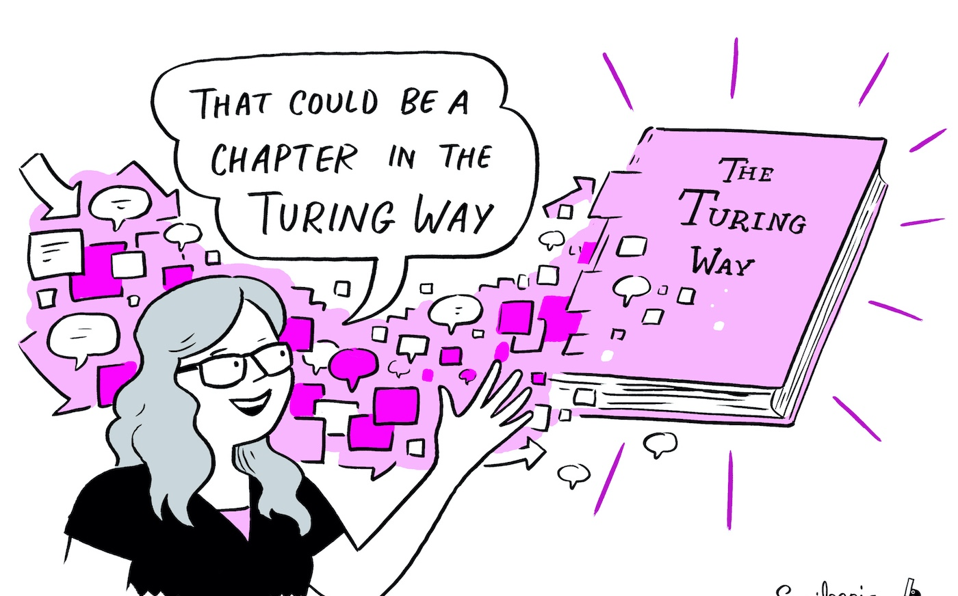
The Turing Way Guides
Reproducibility
Project Design
Communication
https://github.com/alan-turing-institute/the-turing-way, @turingway, CC-BY 4.0. DOI 10.5281/zenodo.7788718. Image credit Scriberia.
Collaboration
Ethical Research
Community Handbook
Notes:
This expansion was in order to recognise all of the things that enable open and reproducible science to happen in the first place. So the project added four more guides: in addition to the guide for reproducible research, we have guides for project design, communication, collaboration and ethical research.
We also record all the community practices that we are developing and practising within the Turing Way in our community handbook so that it can be adopted by other open communities.

Slide 9
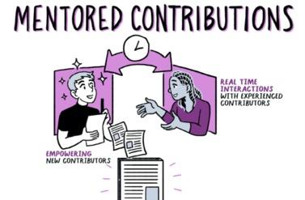
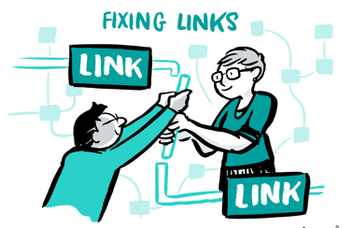




Key Practices for Collaboration
Develop & share
Maintain & improve
Share resources
https://github.com/alan-turing-institute/the-turing-way, @turingway, CC-BY 4.0. DOI 10.5281/zenodo.7788718. Image credit Scriberia.
Review and update
Make it global
Share best practices
Notes:
But! We really want to emphasise that writing a new chapter isn’t the only way to get involved (though it’s definitely something we love to see, and always want to support more of!) As this demonstrates, there are many different ways of getting involved with the project, and in contributing that in many ways always require people to collaborate with each other, and work collectively
[Display the pathways]
Translation: Batool Almazooq, - making the book more accessible in different geographies and languages
Open all the way down, but ensuring that it allows for accessibility and accountability to improving the project… All of this is done with the aims of sharing best practices for open science, and open scholarship more broadly.

Slide 10

Key Practices for Collaboration
Develop & share
Maintain & improve
Share resources
https://github.com/alan-turing-institute/the-turing-way, @turingway, CC-BY 4.0. DOI 10.5281/zenodo.7788718. Image credit Scriberia.
Review and update
Make it global
Share best practices

Slide 11
Overview
What is The Turing Way?
Github Introduction
How to use GitHub for Collaboration
Next Steps
https://github.com/alan-turing-institute/the-turing-way, @turingway, CC-BY 4.0. DOI 10.5281/zenodo.7788718

Slide 12
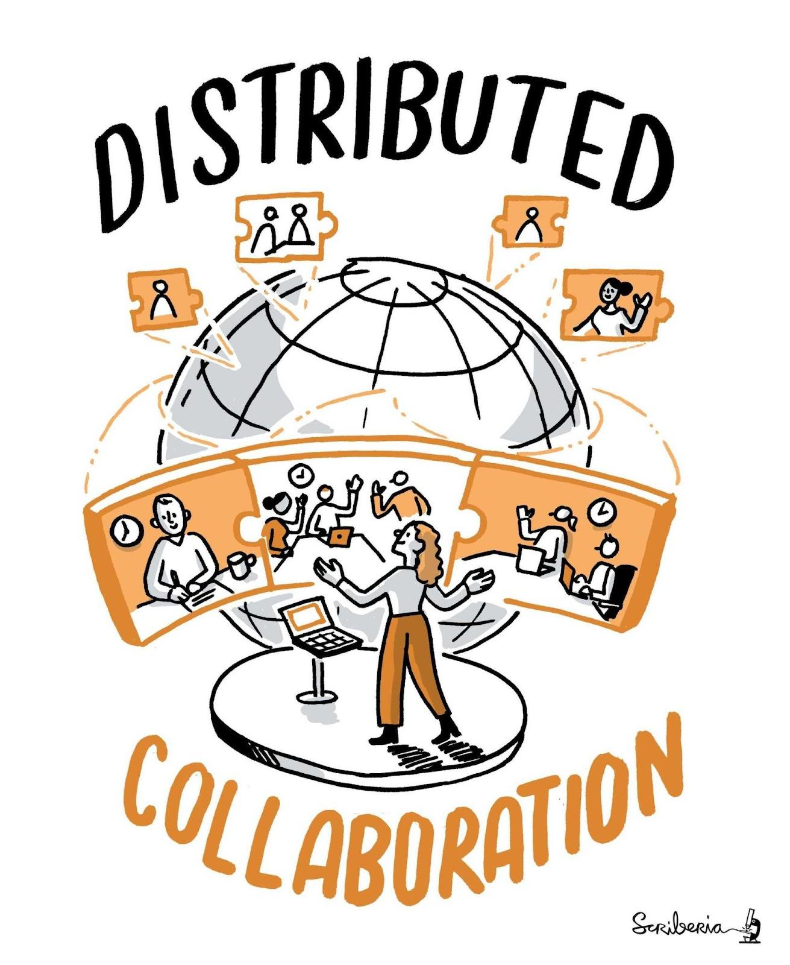
Collaborative Documentation
There are challenges in developing collaborative documents...
https://github.com/alan-turing-institute/the-turing-way, @turingway, CC-BY 4.0. DOI 10.5281/zenodo.7788718. Image credit Scriberia.

Slide 13
Collaborative Documentation
There are challenges in developing collaborative documents…
Asynchronous and conflicting edits, location, time zones, and
https://github.com/alan-turing-institute/the-turing-way, @turingway, CC-BY 4.0. DOI 10.5281/zenodo.7788718. Image credit Scriberia.

Slide 14
Collaborative Documentation
There are challenges in developing collaborative documents…
Asynchronous and conflicting edits, location, time zones, and
VERSIONS!
https://github.com/alan-turing-institute/the-turing-way, @turingway, CC-BY 4.0. DOI 10.5281/zenodo.7788718. Image credit Scriberia.

Slide 15
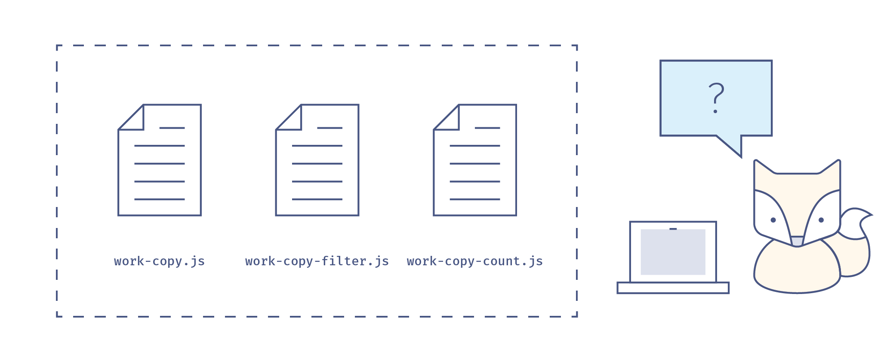
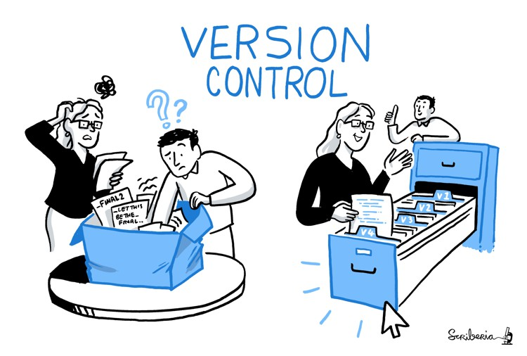
https://github.com/alan-turing-institute/the-turing-way, @turingway, CC-BY 4.0. DOI 10.5281/zenodo.7788718.

Slide 16
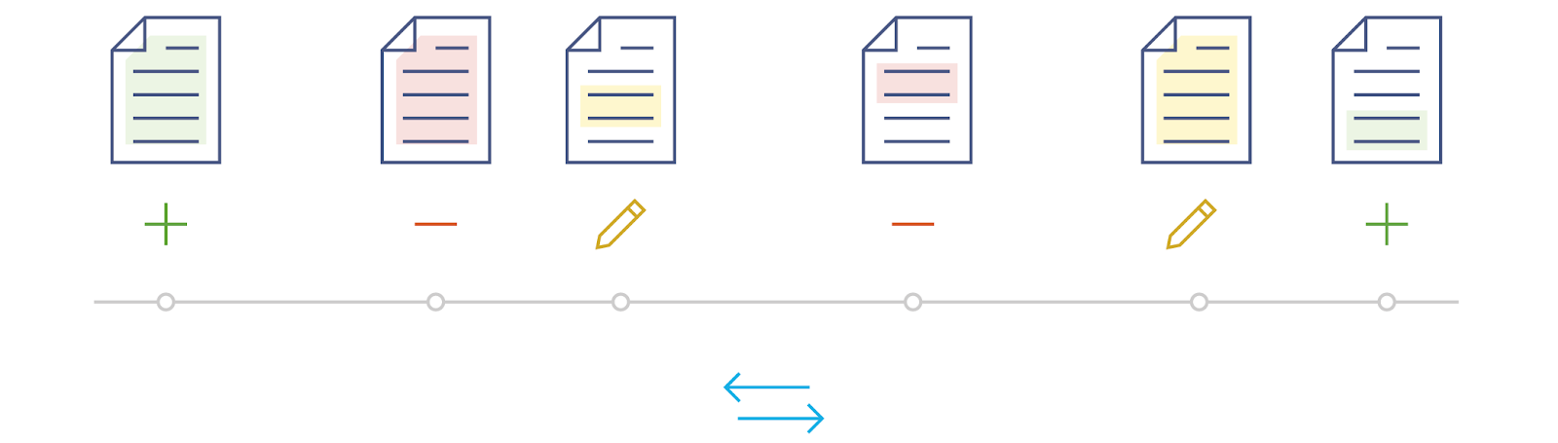
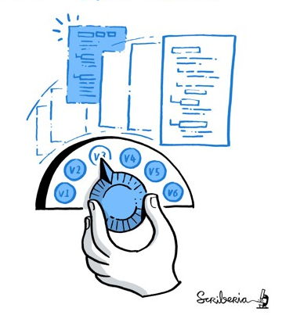
https://github.com/alan-turing-institute/the-turing-way, @turingway, CC-BY 4.0. DOI 10.5281/zenodo.7788718.

Slide 17

Slide by Sophia Batchelor, https://zenodo.org/record/5070361

Slide 18


Git & GitHub
Git is one of the most widely used version control systems in the world. It is free and open source!
You can use git on your computer through the command line or a GUI.
GitHub is a popular website for hosting and sharing projects you have been tracking with git.
This allows other people to work on your project at the same time ✨
https://github.com/alan-turing-institute/the-turing-way, @turingway, CC-BY 4.0. DOI 10.5281/zenodo.7788718

Slide 19
Why use GitHub?
hosts your repositories (projects) online
helps you work with contributors/collaborators
provides web interface for version control
it can be used for project management and communication
useful for any project where a group of people are working together
https://github.com/alan-turing-institute/the-turing-way, @turingway, CC-BY 4.0. DOI 10.5281/zenodo.7788718

Slide 20
Overview
What is The Turing Way?
Github Introduction
How to use GitHub for Collaboration
Next Steps
https://github.com/alan-turing-institute/the-turing-way, @turingway, CC-BY 4.0. DOI 10.5281/zenodo.7788718

Slide 21
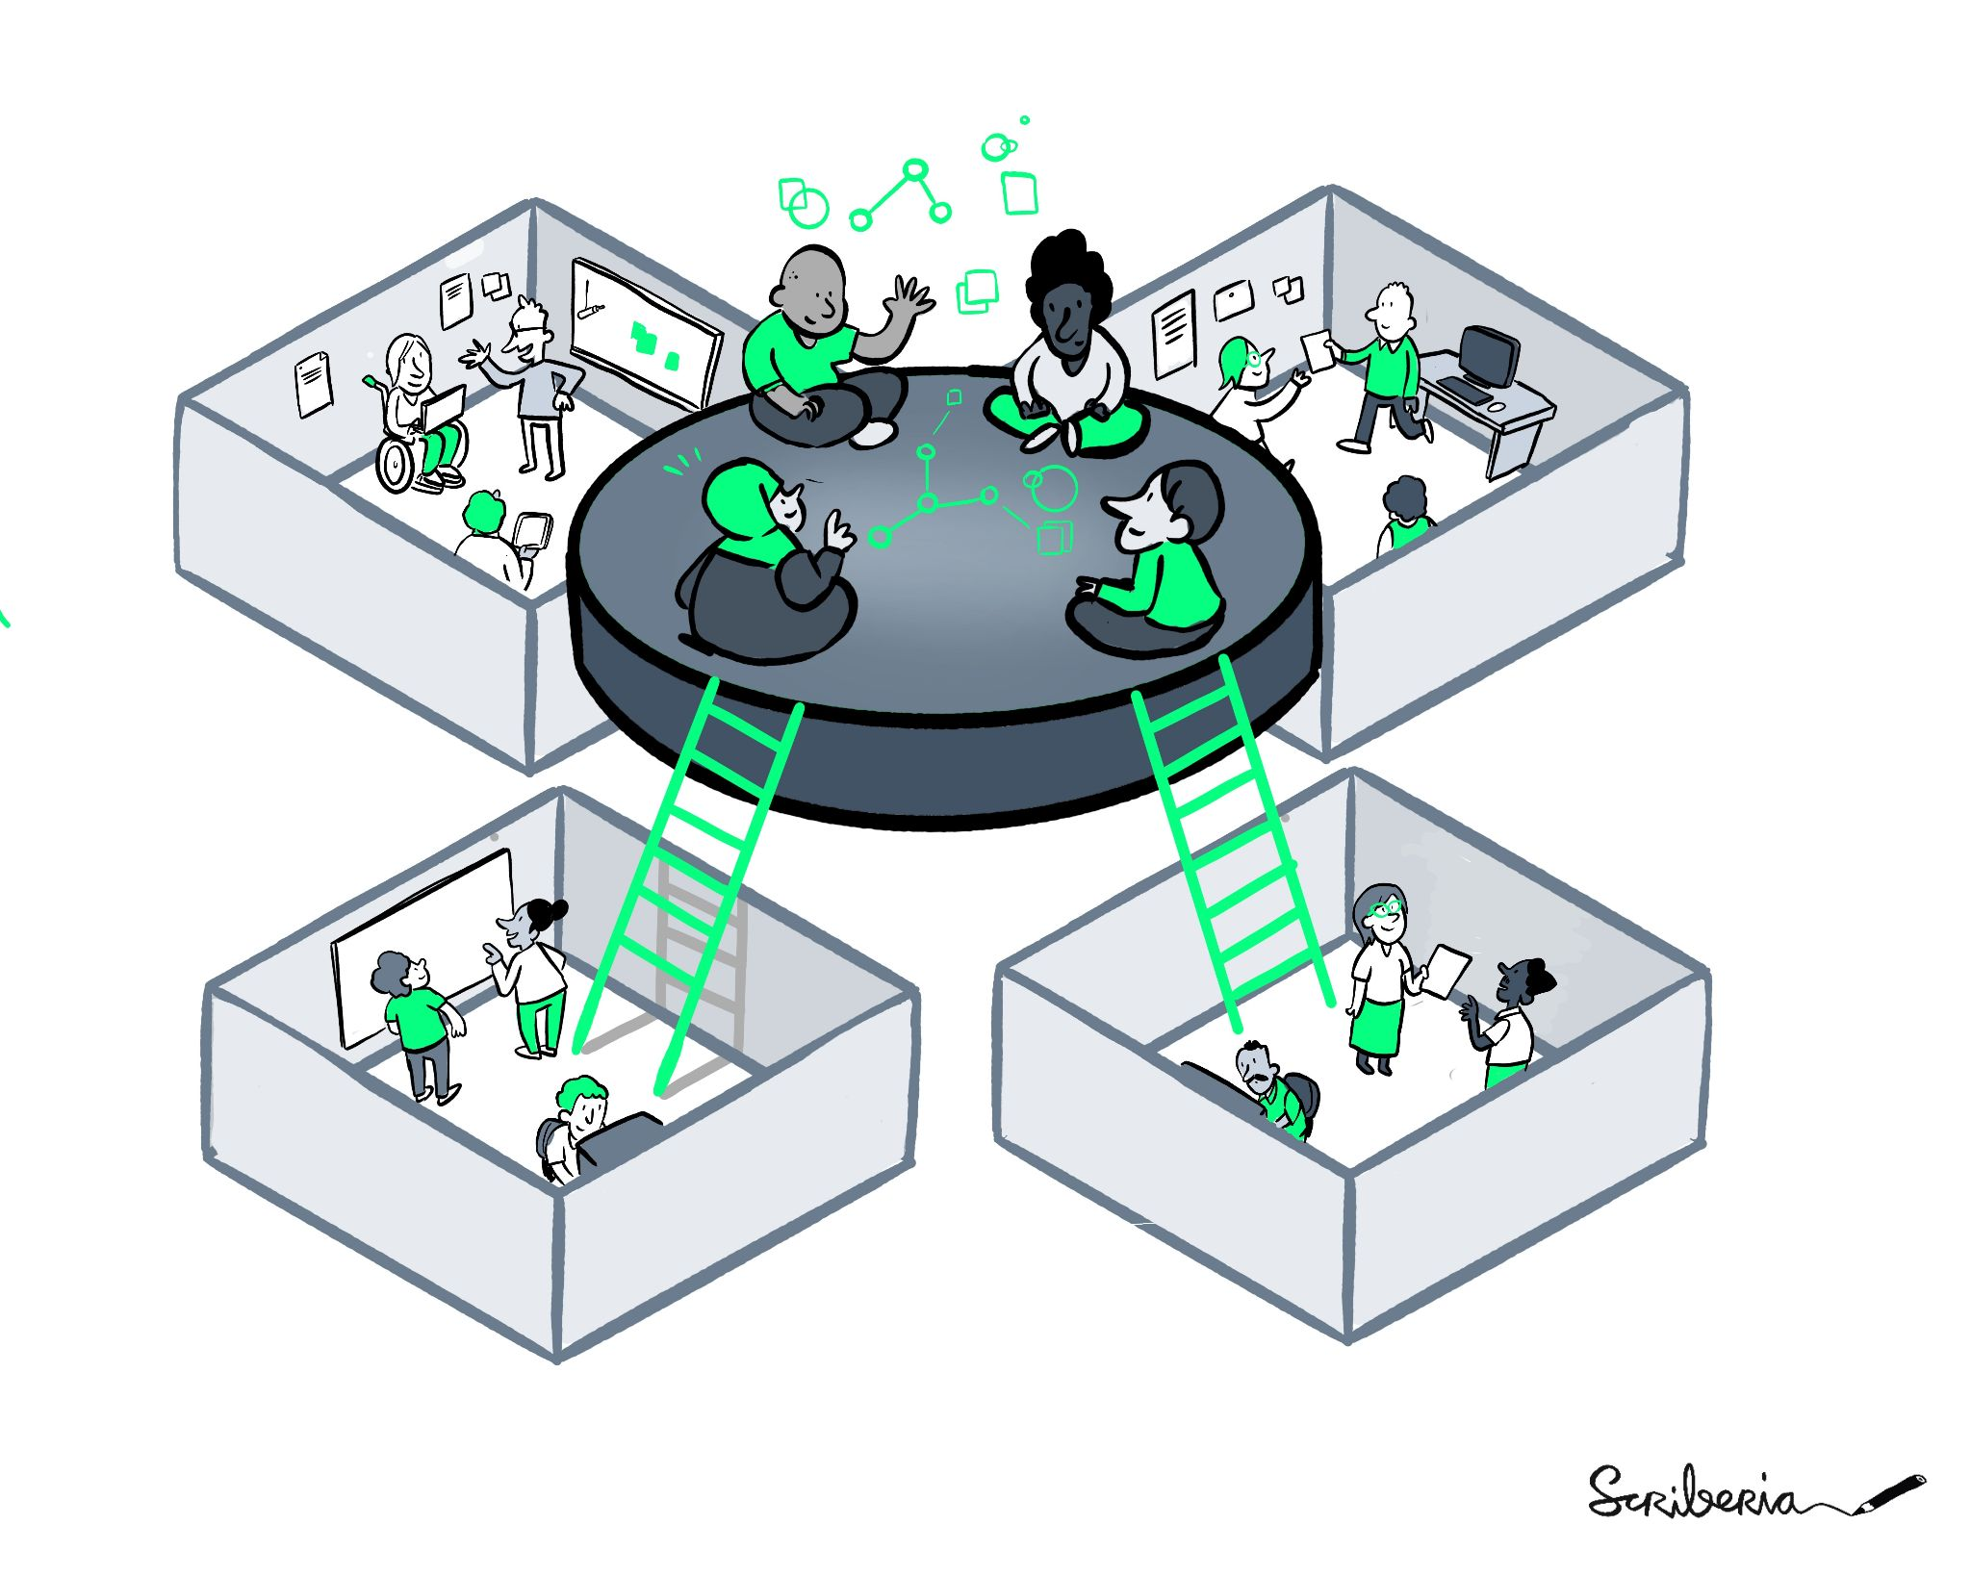
The tools of collaboration
Using Issues to discuss and decide changes
Forking projects
Writing and editing files
Making Pull Requests
https://github.com/alan-turing-institute/the-turing-way, @turingway, CC-BY 4.0. DOI 10.5281/zenodo.7788718. Image credit Scriberia.

Slide 22
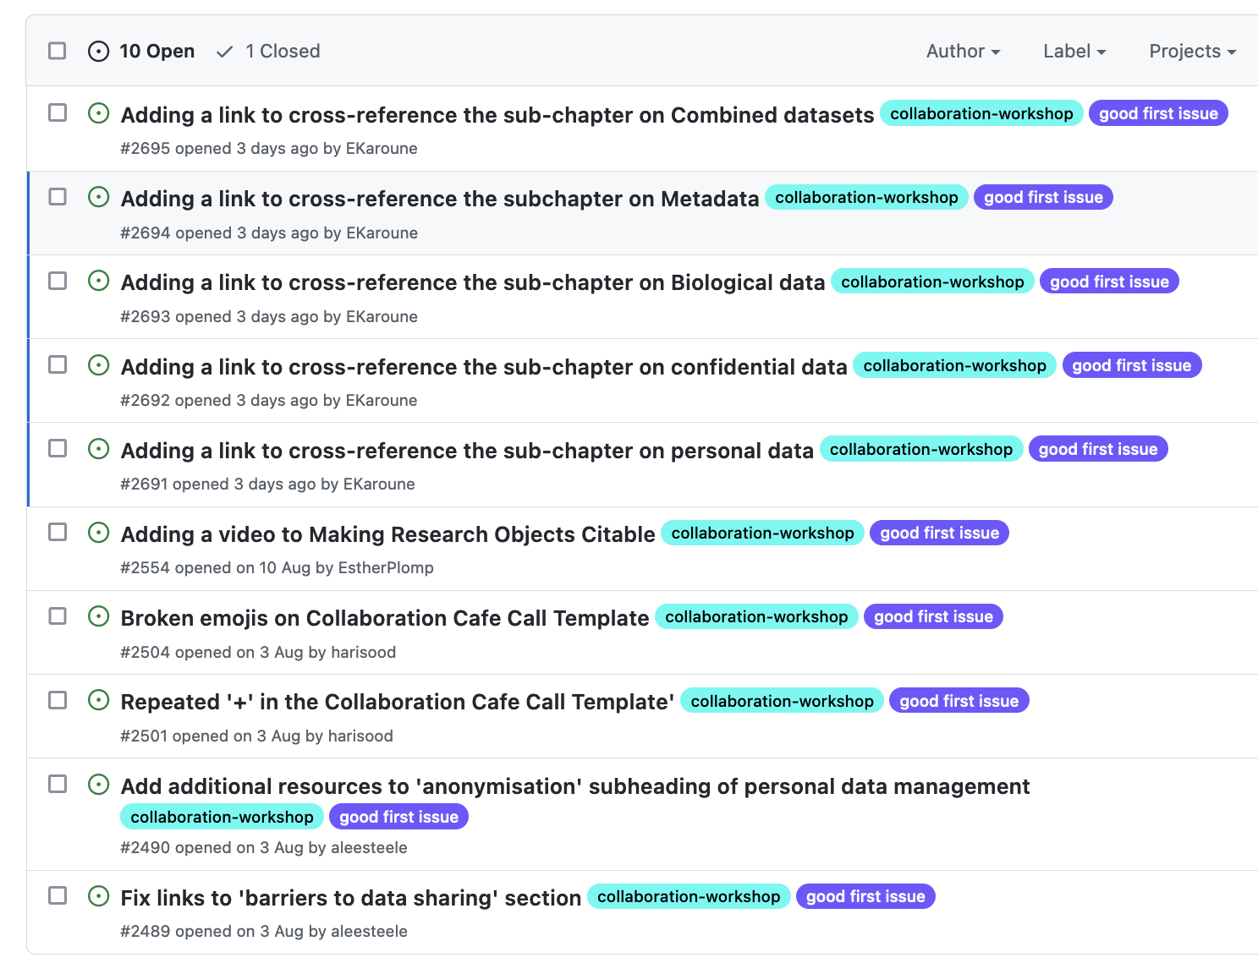
Using Issues for Discussion
With a issues, you can propose ideas for possible changes, and invite discussions.
Different contributors can see what you are working on and offer help, share thoughts or learn from your work.
https://github.com/alan-turing-institute/the-turing-way, @turingway, CC-BY 4.0. DOI 10.5281/zenodo.7788718

Slide 23
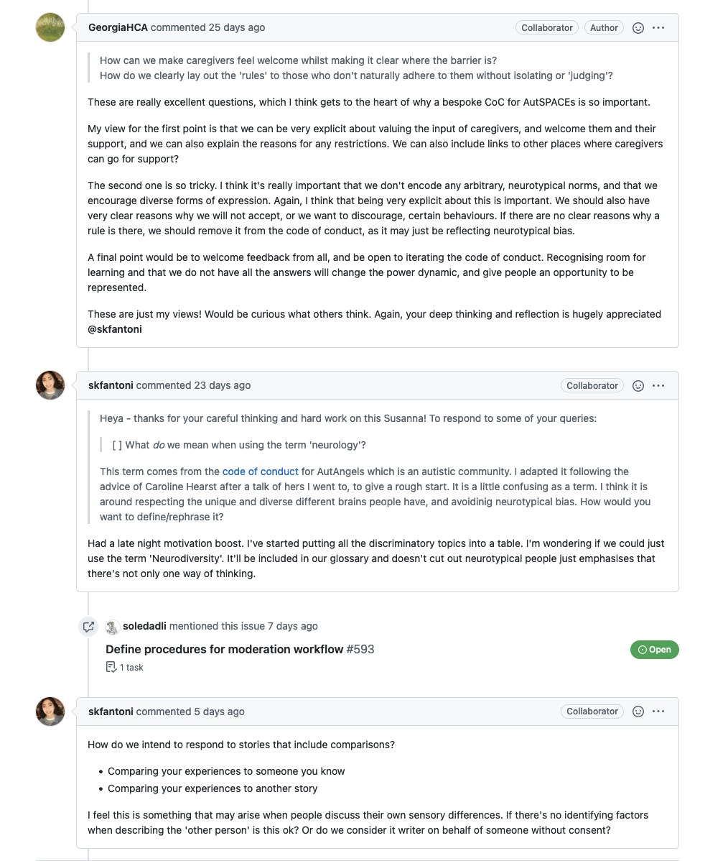
Using Issues for Discussion
With a issues, you can propose ideas for possible changes, and invite discussions.
Different contributors can see what you are working on and offer help, share thoughts or learn from your work.
Provide sufficient details, respond patiently, accept constructive feedback and invite collaboration.
https://github.com/alan-turing-institute/the-turing-way, @turingway, CC-BY 4.0. DOI 10.5281/zenodo.7788718

Slide 24

Using Markdown to write Files
Markdown is a simple text “markup” language made for quickly writing formatted text
Great for blogs, documentation, and even writing papers.
You may have used it in HackMD.
https://github.com/alan-turing-institute/the-turing-way, @turingway, CC-BY 4.0. DOI 10.5281/zenodo.7788718

Slide 25
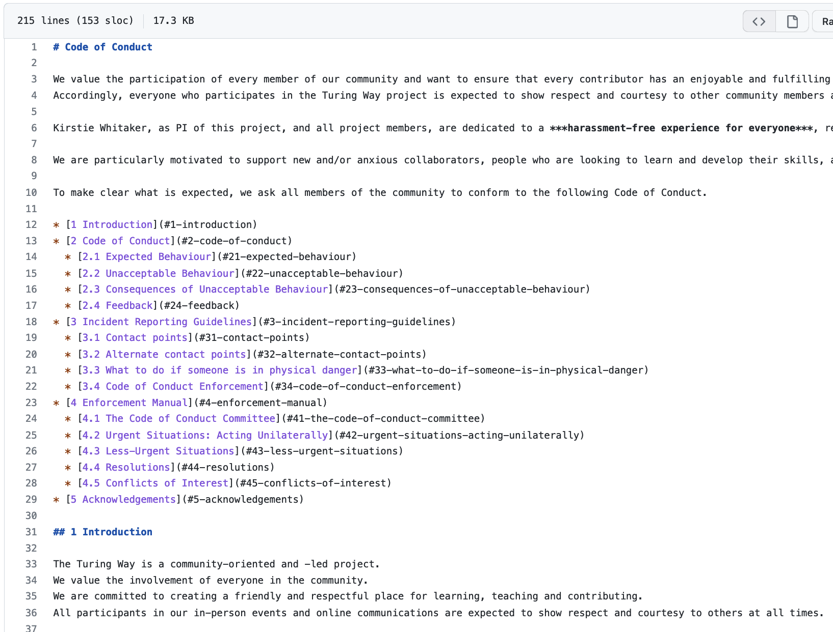
Using Markdown to write Files
Markdown is a simple text “markup” language made for quickly writing formatted text.
You can find guides on Markdown’s syntax here: https://www.markdownguide.org/basic-syntax/
https://github.com/alan-turing-institute/the-turing-way, @turingway, CC-BY 4.0. DOI 10.5281/zenodo.7788718
Notes:
Does everyone have an issue?
Make

Slide 26




GitHub’s Vocab
Commit
Branch & Fork
Pull Request
Merge
https://github.com/alan-turing-institute/the-turing-way, @turingway, CC-BY 4.0. DOI 10.5281/zenodo.7788718

Slide 27
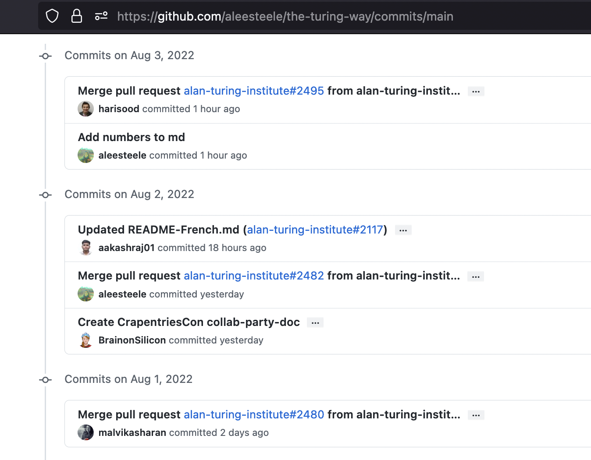
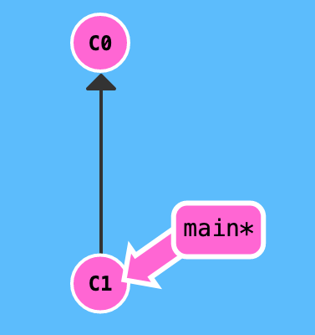
Commit
Saving a version of file(s)
‘commit’ changes with message (i.e.‘My first commit’)
https://github.com/alan-turing-institute/the-turing-way, @turingway, CC-BY 4.0. DOI 10.5281/zenodo.7788718

Slide 28
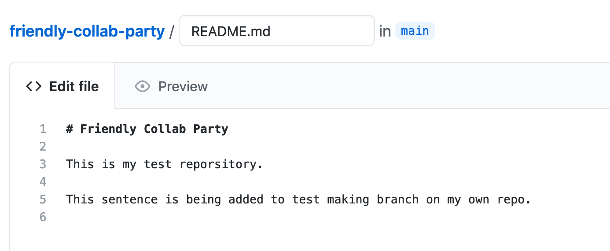
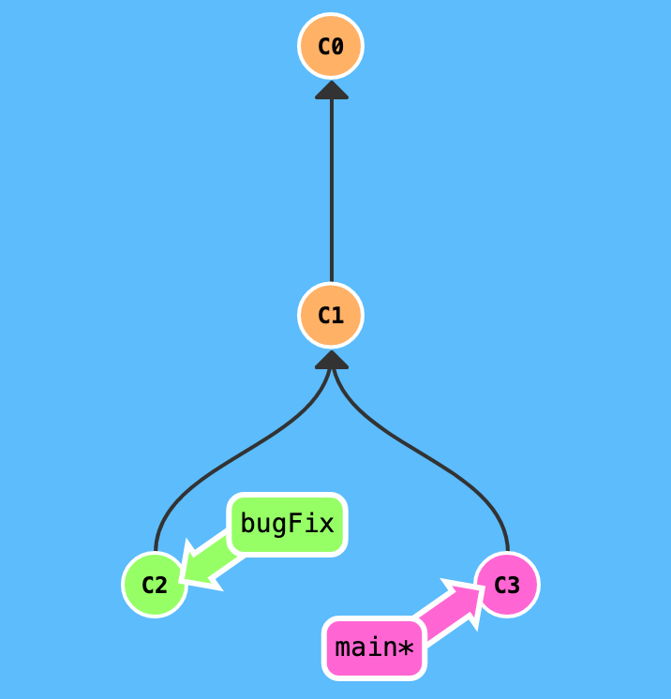
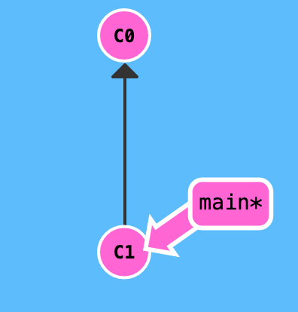
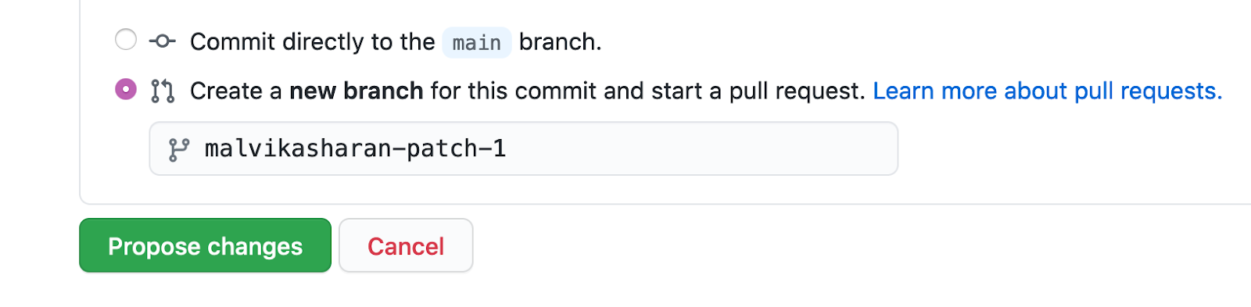
Branch & Fork
Branch: pointers to a specific commit in your repo, temporary places to work through a feature ← you have write access
https://github.com/alan-turing-institute/the-turing-way, @turingway, CC-BY 4.0. DOI 10.5281/zenodo.7788718

Slide 29
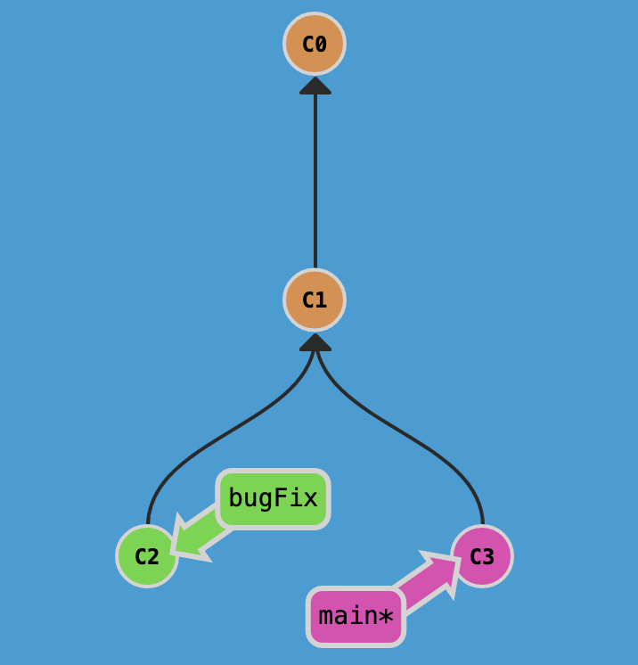

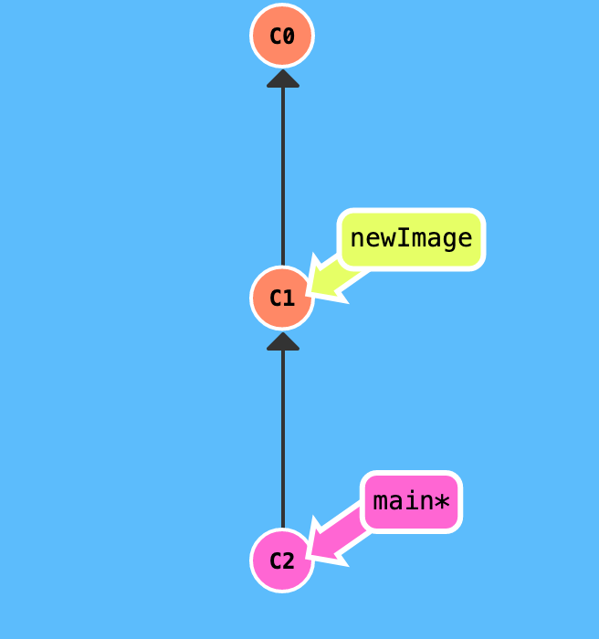

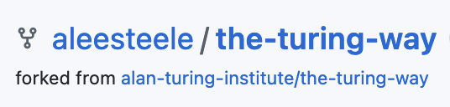
Branch & Fork
Branch: pointers to a specific commit in your repo, temporary places to work through a feature ← you have write access
Fork: copy of repo that is an entirely independent repo ← no need of write access or intent to merge with the main
https://github.com/alan-turing-institute/the-turing-way, @turingway, CC-BY 4.0. DOI 10.5281/zenodo.7788718

Slide 30
Fork & Pull Request.
If you don’t own a repo and aren’t an official collaborator:
you will Fork a repo
work on your forked copy of the repo
make a Pull Request for the changes you’ve made
author/owner will decide to merge them in.
Make friends + Big party!
https://github.com/alan-turing-institute/the-turing-way, @turingway, CC-BY 4.0. DOI 10.5281/zenodo.7788718

Slide 31
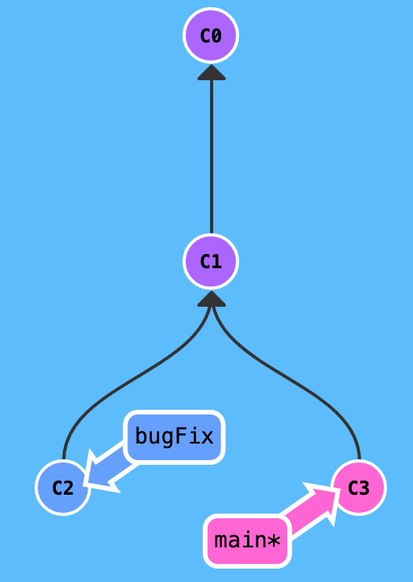
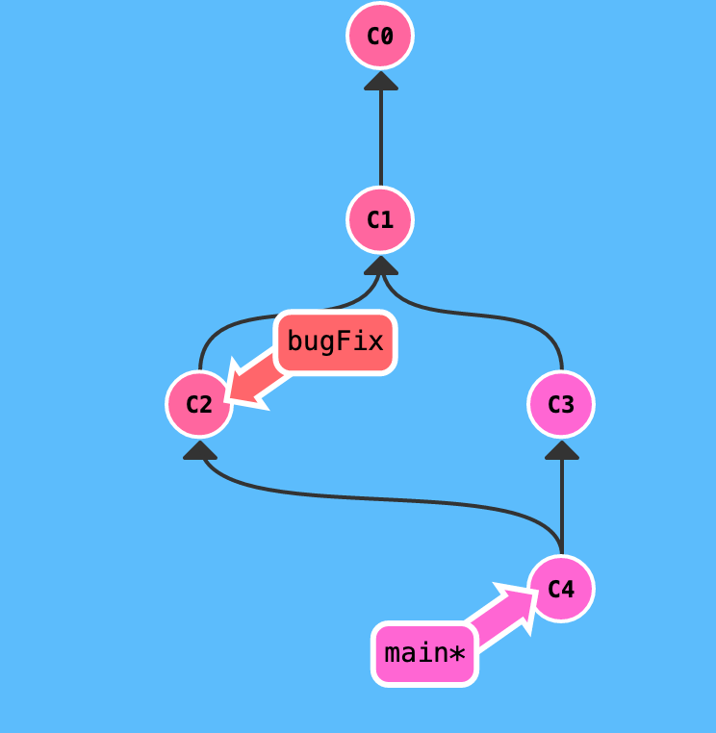
Pull Request & Merge
Pull Request
request to add your changes from a branch back into main.
Merge
act of incorporating new changes (commits) from one branch to another.
https://github.com/alan-turing-institute/the-turing-way, @turingway, CC-BY 4.0. DOI 10.5281/zenodo.7788718
Notes:
Are there any questions?

Slide 32
Pull Request & Merge
Pull Request
request to add your changes from a branch back into main.
Merge
act of incorporating new changes (commits) from one branch to another.
https://github.com/alan-turing-institute/the-turing-way, @turingway, CC-BY 4.0. DOI 10.5281/zenodo.7788718
Notes:
Are there any questions?

Slide 33

Demo: Forking and editing a file.
I’ll first talk through how to fork the project, then how to edit a file using markdown and make a Pull Request. No need to do this with me. Just listen in :)
@turingway, CC-BY 4.0. DOI 10.5281/zenodo.7788718
Image from https://tenor.com/view/yoda-watch-and-learn-gif-15256521

Slide 34
The tools of collaboration
Using Issues to discuss and decide changes
Forking projects
Writing and editing files
Making Pull Requests
https://github.com/alan-turing-institute/the-turing-way, @turingway, CC-BY 4.0. DOI 10.5281/zenodo.7788718. Image credit Scriberia.

Slide 35

GitHub Exercise!
Let’s find an Issue to work on, fork the project, edit a file, and submit a Pull Request (PR).
We’ll talk through it first, and then we’ll do it together.
@turingway DOI 10.5281/zenodo.7788718
Image from https://tenor.com/view/sonic-lets-do-this-lets-do-it-lets-go-lets-do-that-gif-25751265

Slide 36
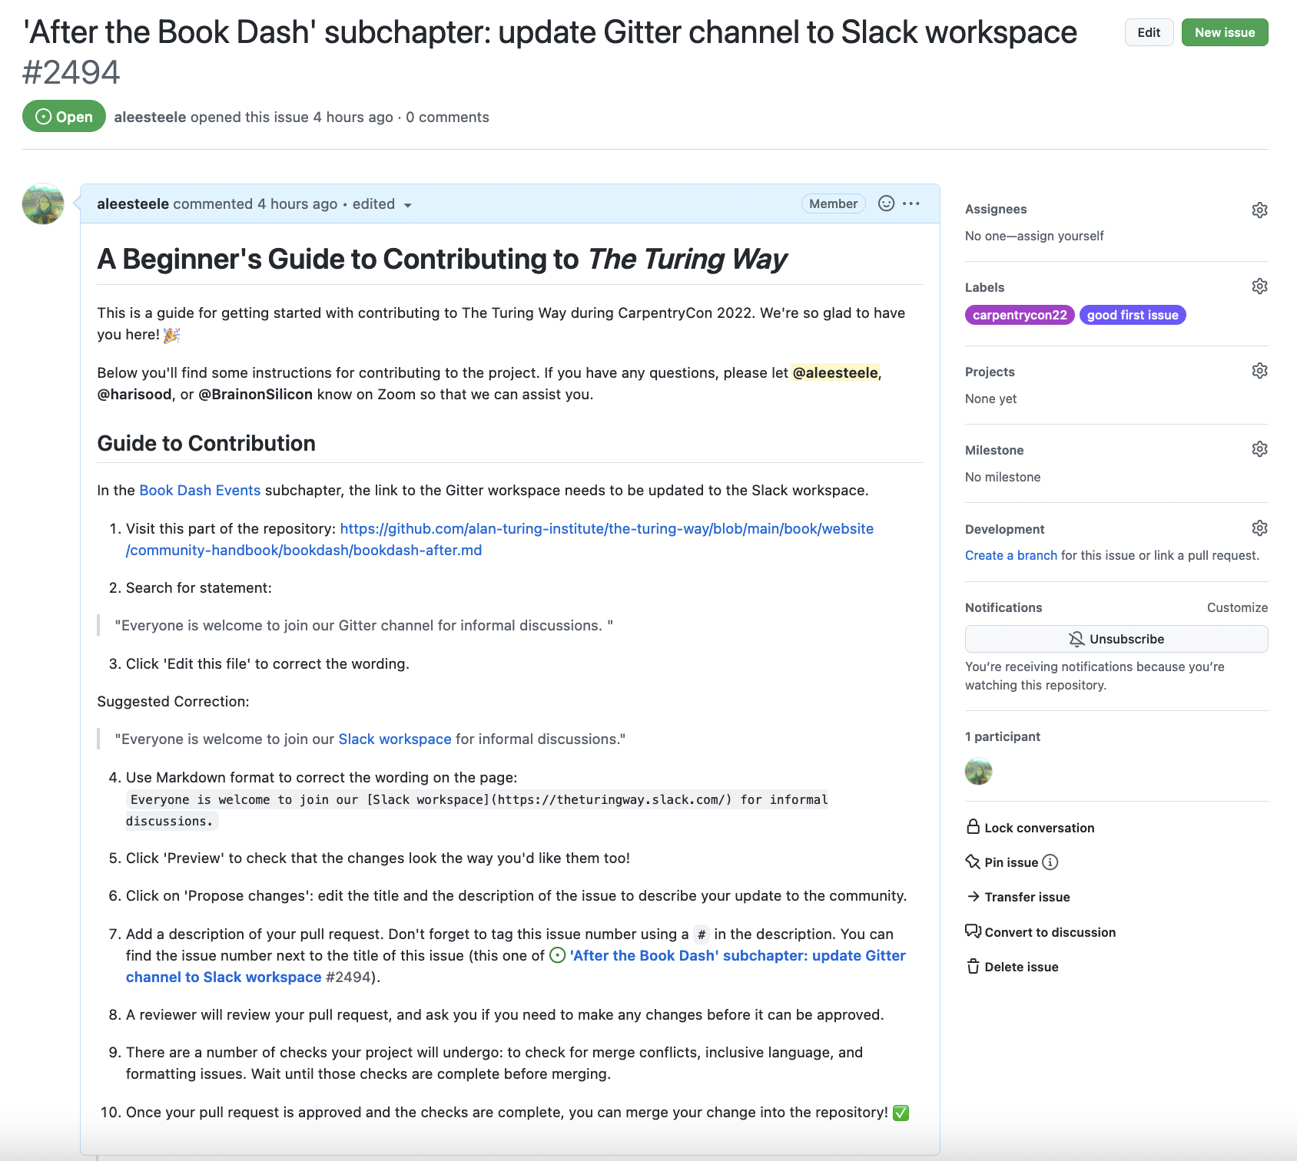
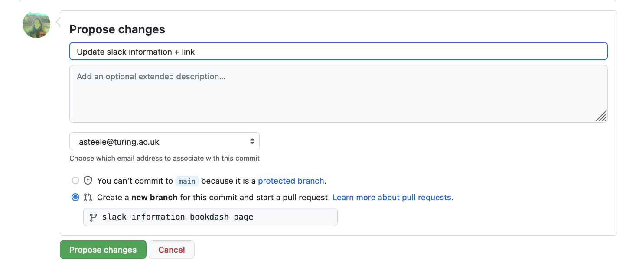
Contributing to The Turing Way: Making a Pull Request
https://github.com/alan-turing-institute/the-turing-way, @turingway, CC-BY 4.0. DOI 10.5281/zenodo.7788718
Issue
Propose Changes

Slide 37
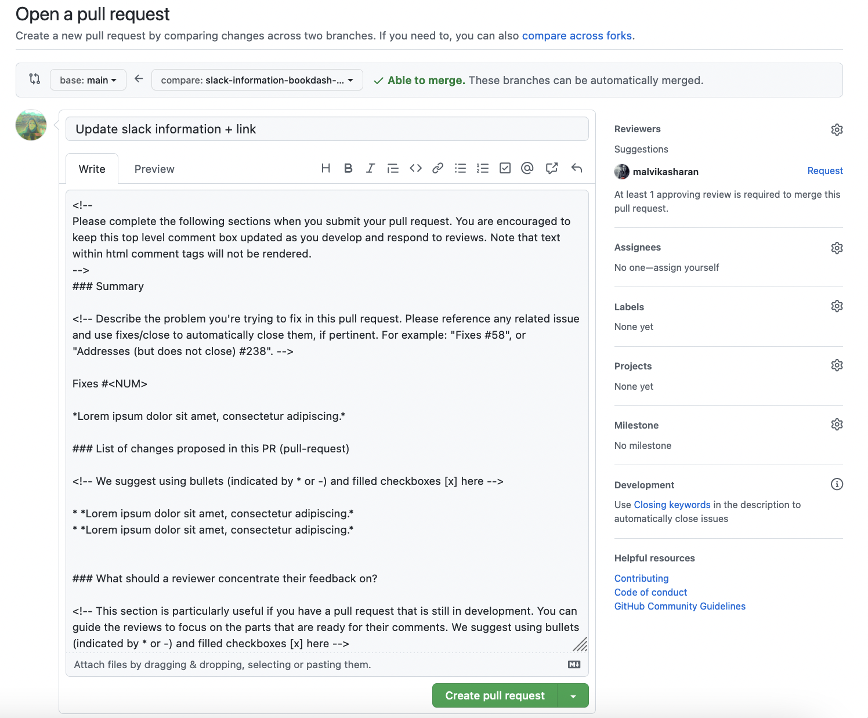
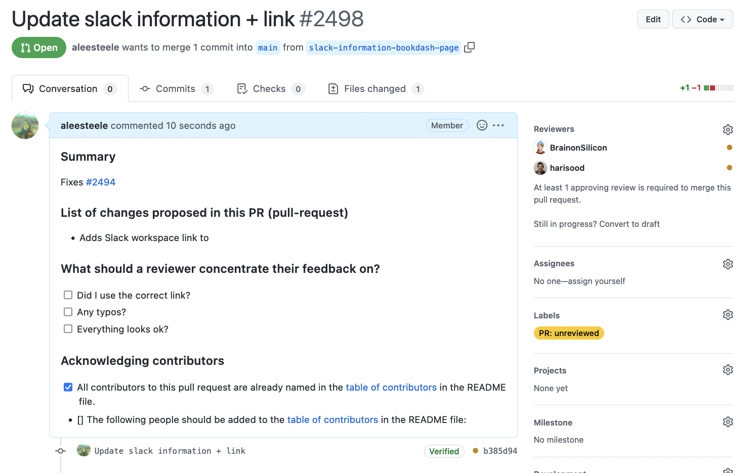
Contributing to The Turing Way: Making a Pull Request
Create Pull Request
Editing Pull Request
https://github.com/alan-turing-institute/the-turing-way, @turingway, CC-BY 4.0. DOI 10.5281/zenodo.7788718

Slide 38

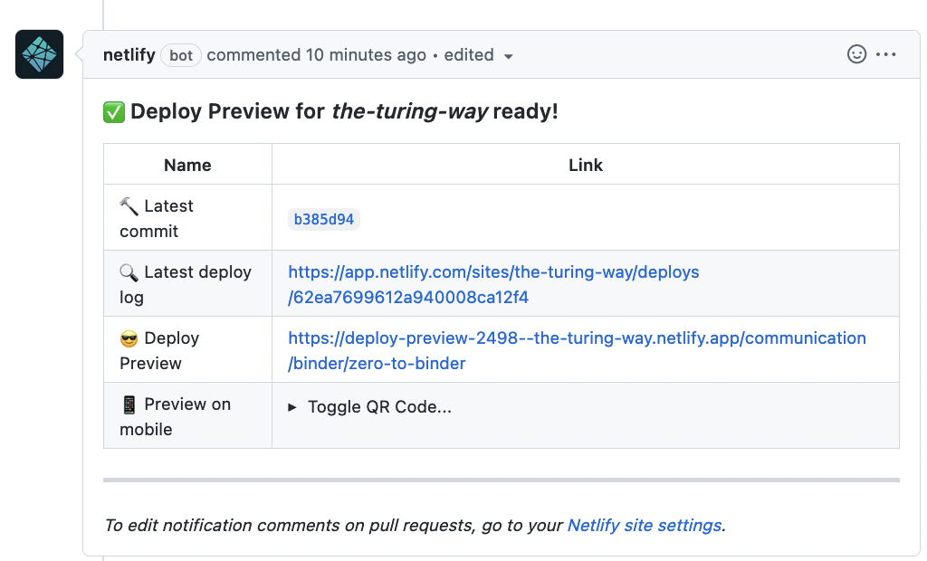
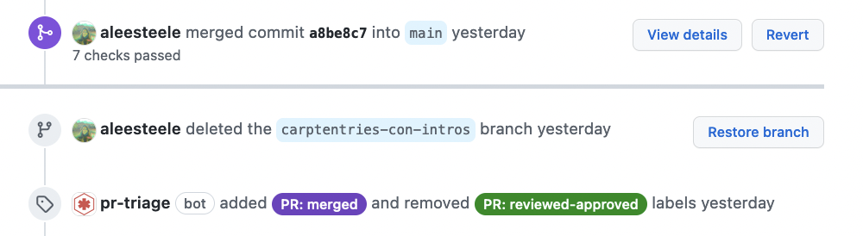
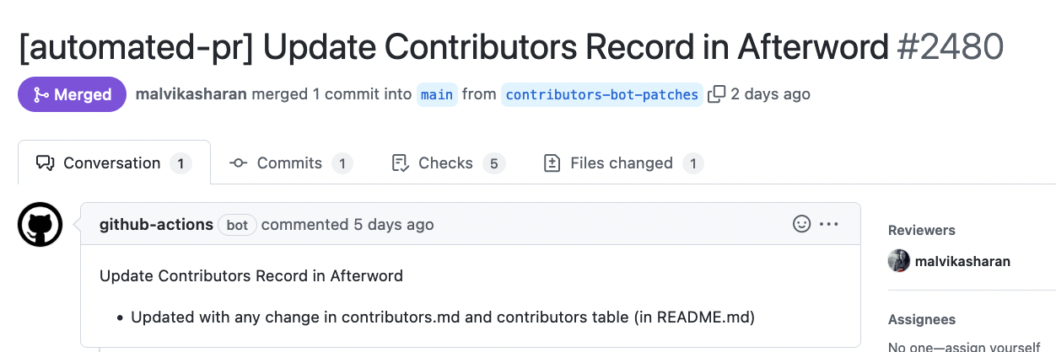
Contributing to The Turing Way: Issues & Pull Requests
https://github.com/alan-turing-institute/the-turing-way, @turingway, CC-BY 4.0. DOI 10.5281/zenodo.7788718
Review Pull Request
Merge changes!

Slide 39
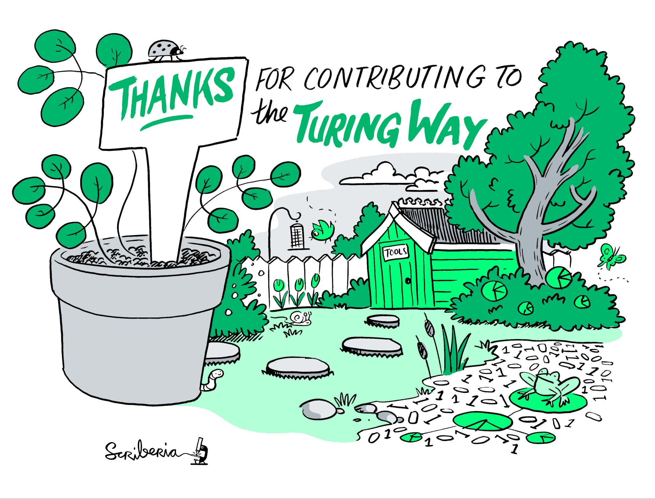
Image. The Turing Way project illustration by Scriberia. Used under a CC-BY 4.0 licence. DOI: 10.5281/zenodo.3332807.¶
Contributing to The Turing Way: DEMO!
I’ll do an example: https://github.com/alan-turing-institute/the-turing-way/issues/3007
https://github.com/alan-turing-institute/the-turing-way, @turingway, CC-BY 4.0. DOI 10.5281/zenodo.7788718. Image credit Scriberia.

Slide 40
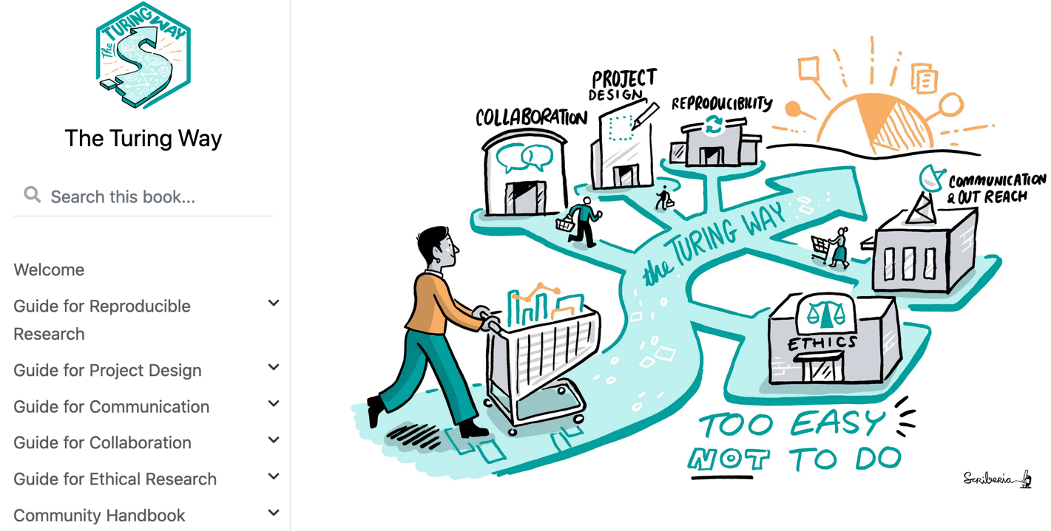

So you’ve learned how to contribute to an open source project…
https://github.com/alan-turing-institute/the-turing-way, @turingway, CC-BY 4.0. DOI 10.5281/zenodo.7788718. Image credit Scriberia.
Notes:
We promote our resources for use by learners, educators, policymakers and researchers globally.
<you can select what you want to talk about>
Some of the notable impact we had in 2020 with the support of our contributors are that the project was highlighted in the EU report for reproducibility for the scientific result, a policy by the Mayor of London On an emerging technology charter used The Turing Way for informing their open and inclusive projects, a funding call from UKRI referenced the project for the example of data science culture, communities for training like code refinery and library carpentries have cross-referenced The Turing Way and the work has been cited by multiple peer-reviewed articles.

Slide 41
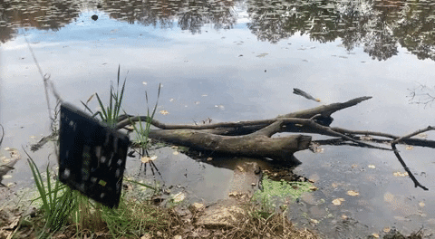
Contributing to Open Source Projects
It’s hard work!
The Turing Way has a huge community of volunteers to help support you so have fun.
@turingway, CC-BY 4.0. DOI 10.5281/zenodo.7788718
Image. Used under a CC-BY 4.0 licence. DOI: 10.5281/zenodo.3332807.¶

Slide 42

Acknowledgements:
Kirstie Whitaker, Malvika Sharan, The Turing Way community, friends & collaborators
GitHub workshop based on Friendly GitHub Intro by Kirstie Whitaker & GitHub Collaborating Document by Malvika Sharan
Stay in Touch
– Book: the-turing-way.netlify.com
Join Slack: https://tinyurl.com/jointuringwayslack
Twitter: twitter.com/turingway
Newsletter: tinyletter.com/TuringWay
– Mastodon: https://fosstodon.org/@turingway
GitHub: github.com/alan-turing-institute/the-turing-way
Original artwork by Scriberia: https://doi.org/10.5281/zenodo.3332807
Contact us: sbatchelor@turing.ac.uk, asteele@turing.ac.uk
https://github.com/alan-turing-institute/the-turing-way, @turingway, CC-BY 4.0. DOI 10.5281/zenodo.7788718.
Notes:
Thanks to Kirstie Whitaker for starting this project. All our resources including this presentation are available online. With that, I am happy to take any question.

Slide 43
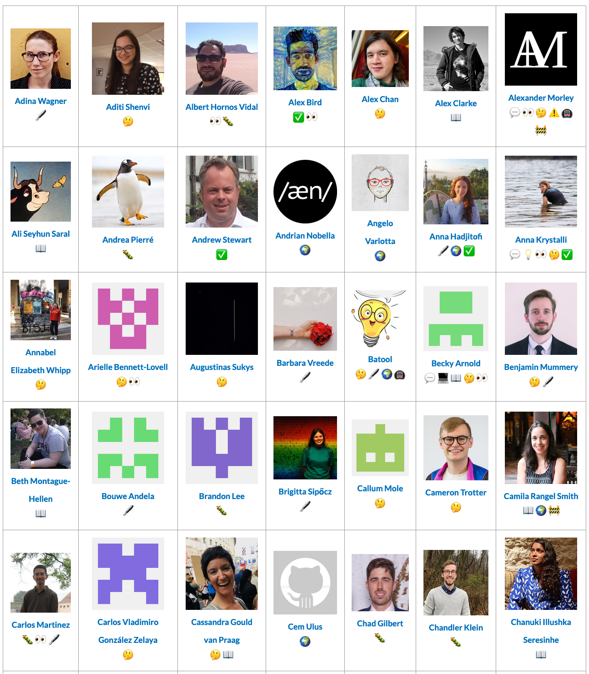
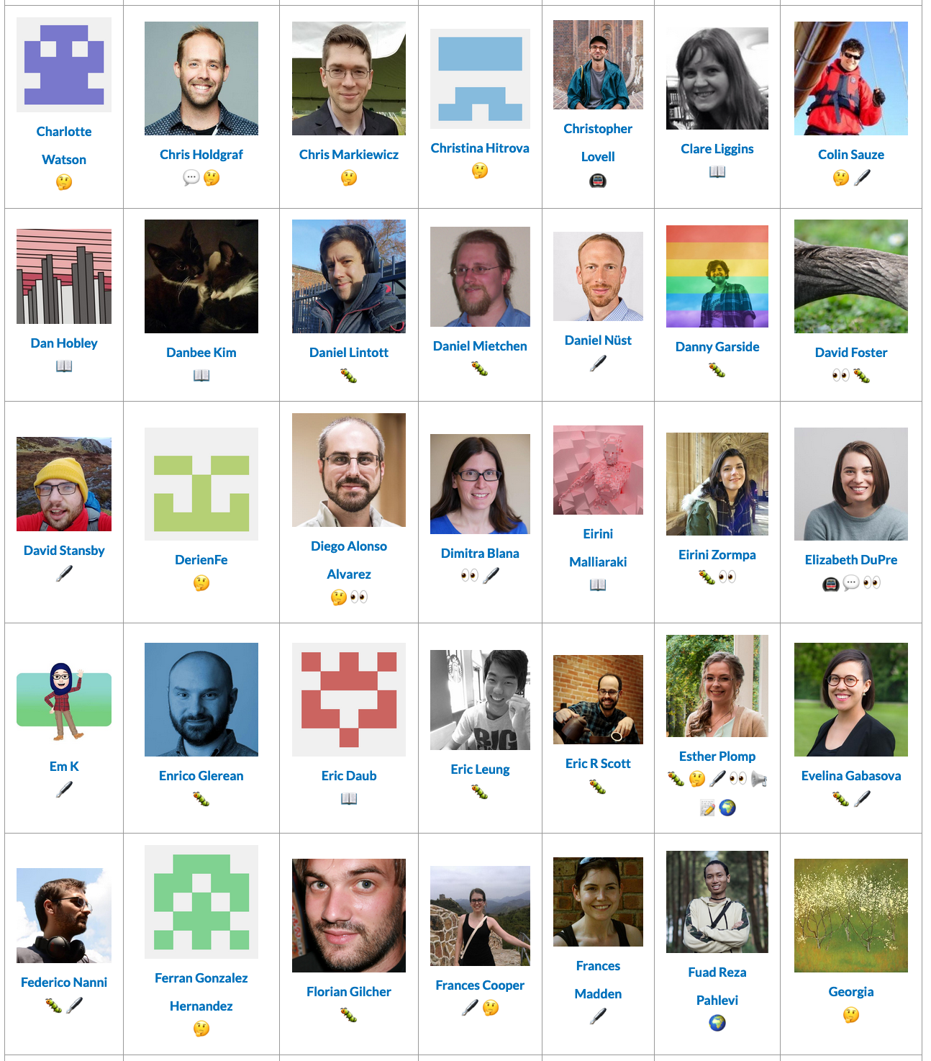
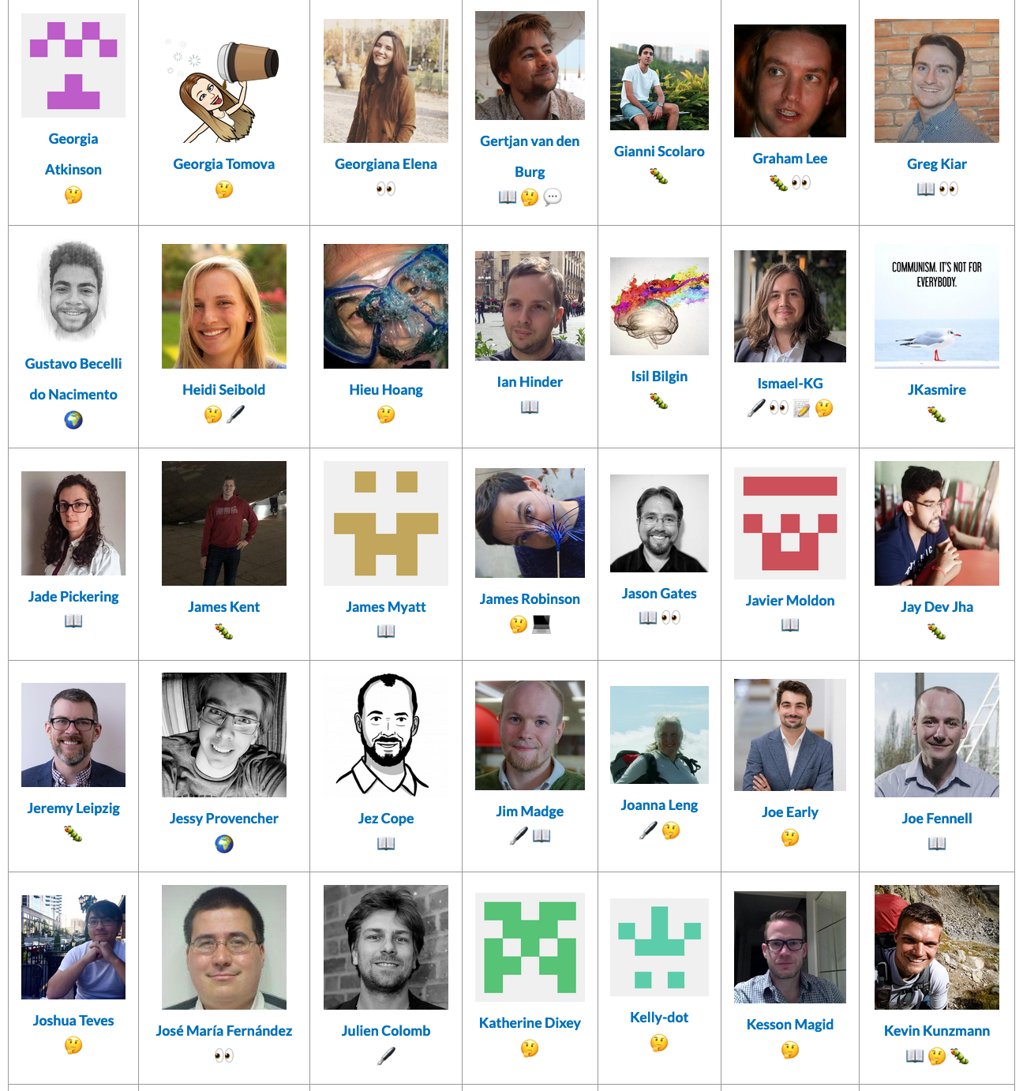
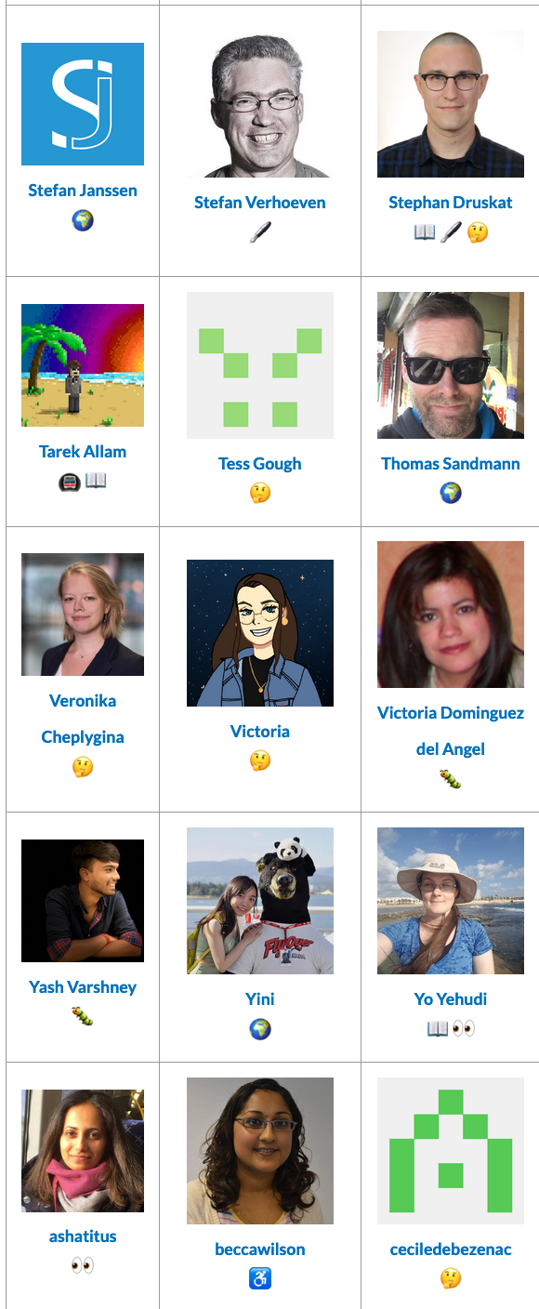

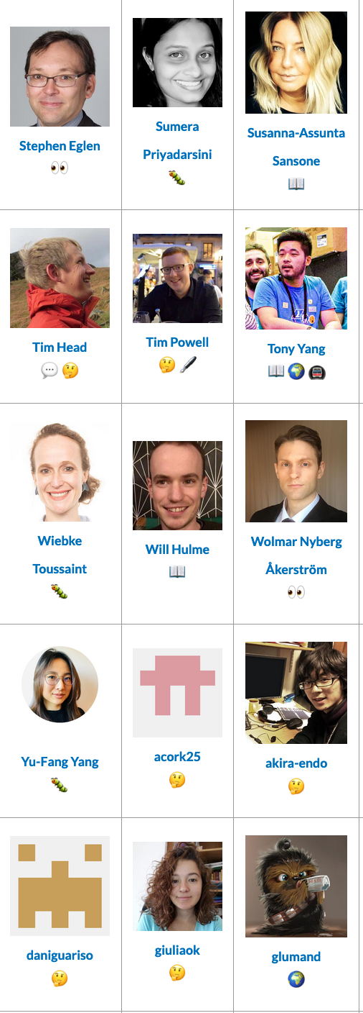

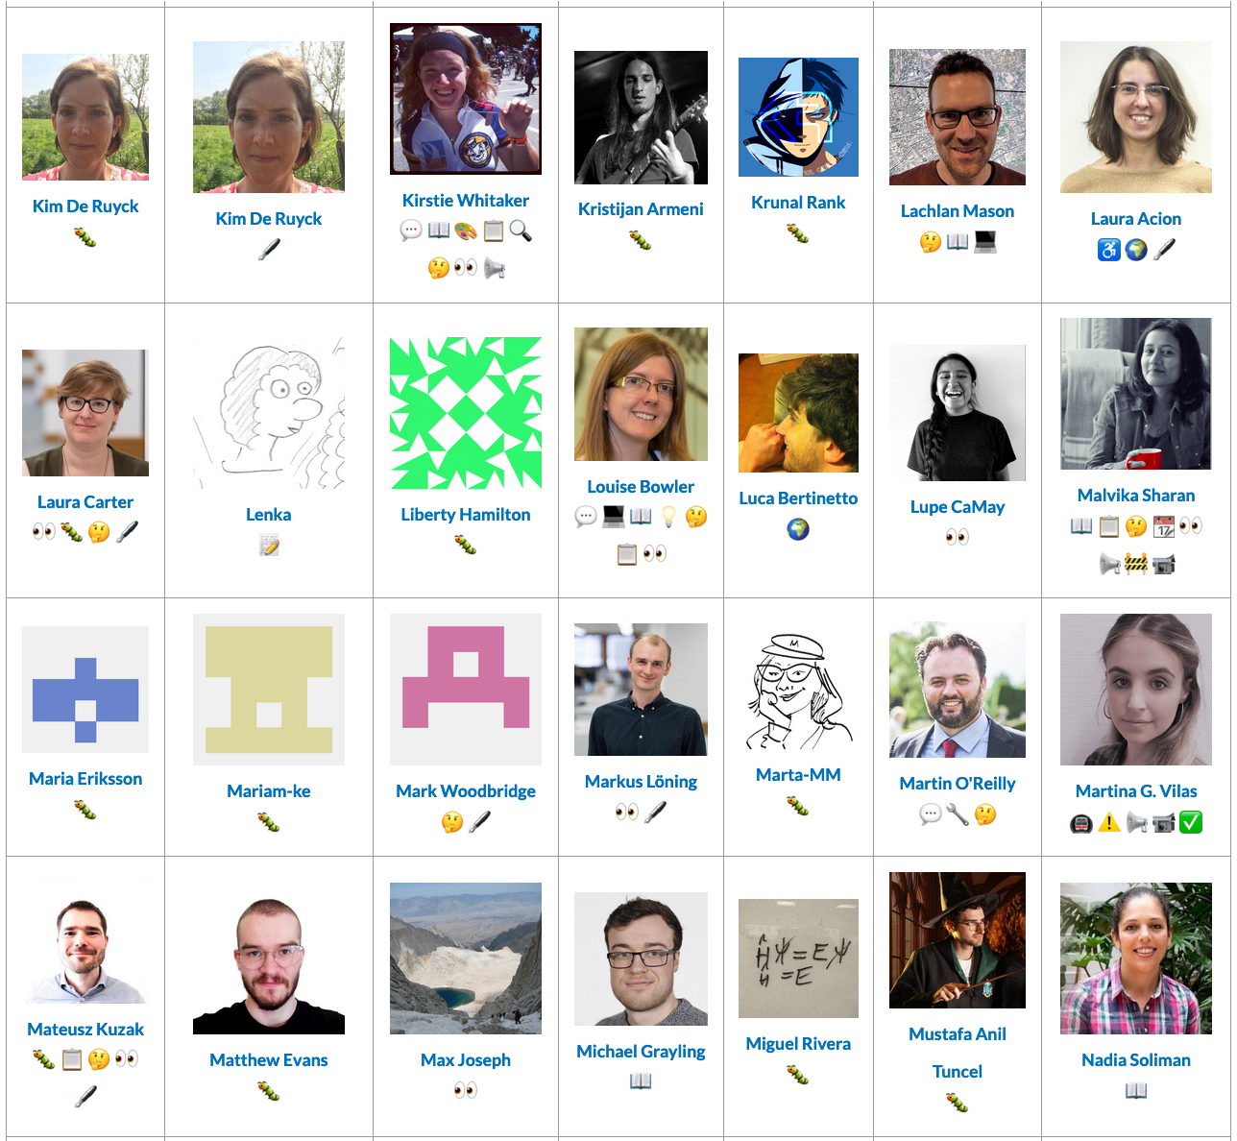
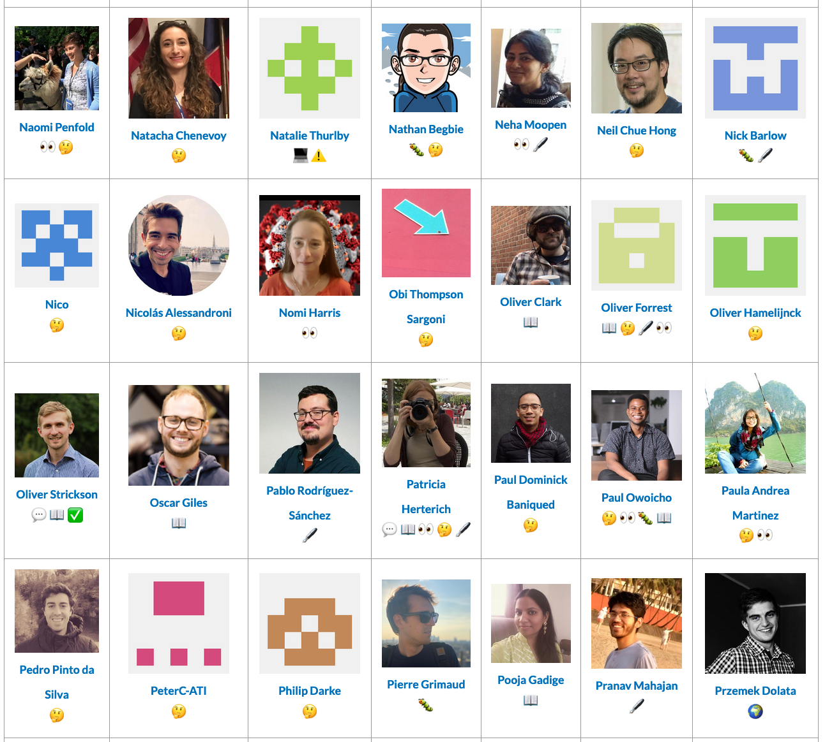




Thanks to our community of contributors & users!
Notes:
None of this work would be possible without our community of collaborators.
We'd like to invite you to become a contributor to the Turing Way, to help us develop chapters of data, transparent reporting, communication and other topics that can help others to stay updated with current practices. We welcome all kinds of contributions.
Case studies, and lived experiences, are welcome too. You don't need to have coding experience to contribute! You just need an idea and a willingness to learn.

Slide 44
Overview
What is The Turing Way?
Github Introduction
How to use GitHub for Collaboration
Next Steps
https://github.com/alan-turing-institute/the-turing-way, @turingway, CC-BY 4.0.

Slide 45
Next Steps…
Find an issue!
https://github.com/aim-rsf/Glossary-of-Terms/issues/24
https://github.com/aim-rsf/Glossary-of-Terms/issues/23
https://github.com/aim-rsf/Glossary-of-Terms/issues/22
Image from https://tenor.com/view/yoda-watch-and-learn-gif-15256521

Slide 46

Creating a Repo.
Repository (Repo)
A project where all your files are, online or on your computer
Notes:
TALK THROUGH THIS SLIDE AND THEN THE DEMO WILL BE SHORTER

Slide 47
Creating a Repo.
“trial-repo”
Repository (Repo)
A project where all your files are, online or on your computer
Notes:
TALK THROUGH THIS SLIDE AND THEN THE DEMO WILL BE SHORTER

Slide 48

CONGRATS!!
You created your first repo.
Slide by Sophia Batchelor, https://zenodo.org/record/5070361, https://tenor.com/view/flower-power-rainbow-yeah-gif-7304860

